Slide 1
UNDERSTAND SECURING NETWORK CONNECTIVITY IN AZURE

Slide 2
Executive summary
Applications that are exposed to the public Internet are protected by network features such as Azure Firewall, Network Security Groups, and DDoS Protection.
Your Azure account is protected with identity offerings such as Azure Active Directory and multi-factor authentication.
Data and other assets, such as documents and emails, are protected by features such as Azure Key Vault and Azure Information Protection.
Azure can constantly monitor your cloud resources for signs of attack using Azure Advanced Threat Protection.
Azure Security Center provides recommendations based on your resources, and how they’re configured, so that you can proactively prevent threats in the first place.
Azure Policies and Role-Based Access Control ensure that users with legitimate access to your subscription are able to access only those resources you desire, and you can even lock resources so they can’t be reconfigured or deleted by mistake
Azure Monitor and Azure Service Health ensure you always know what’s happening with your Azure resources.
Microsoft Trust Center is a website that teaches you how Azure secures and protects your data in the cloud, and the Service Trust Portal is a website offering tools such as Azure Compliance Manager that helps ensure you’re compliant with standards that are important to you.
Source: …

Slide 3
Agenda
Understanding securing network connectivity in Azure
DDoS protection
Network Security Groups
Choosing an appropriate Azure security solutions

Slide 4
UNDERSTAND SECURING NETWORK CONNECTIVITY IN AZURE
The primary attack vector for applications and data in the cloud is the network, and if your application is exposed to the public Internet, the threat is much greater. Web applications are often the target of attacks that are intended to either bring an application down or to obtain unauthorized access to data.
A firewall is an appliance through which network traffic into and out of a particular network travels. The purpose of a firewall is to allow only desired traffic on the network, and to reject any traffic that might be malicious or that comes from an unknown origin. A firewall imposes control on the network using rules that specify a source and destination IP address range and port combination.
In a typical firewall configuration, all traffic is denied by default. In order for the firewall to allow traffic to pass through it, a rule must match that traffic.
Azure Firewall

Slide 5
UNDERSTAND SECURING NETWORK CONNECTIVITY IN AZURE
There are several firewalls available from third-parties in the Azure Marketplace, but Microsoft also offers its own firewall called Azure Firewall. Azure Firewall is a PaaS offering in Azure, and it’s easily managed and offers a 99.95% SLA. Azure Firewall scales according to your networking needs, so you don’t have to worry about traffic spikes causing latency or downtime for your applications.
Azure Firewall is a stateful firewall. That means that it stores data in its memory about the state of network connections that flow through it. When new network packets for an existing connection hit the firewall, it’s able to tell if the state of that connection represents a security threat.
Azure Firewall

Slide 6
UNDERSTAND SECURING NETWORK CONNECTIVITY IN AZURE
A typical setup for Azure Firewall consists of the following:
A centralized hub network that contains the Azure Firewall and a VM that operates as a jumpbox. The firewall exposes a public IP address, but the jumpbox VM does not.
One or more additional networks (called spoke networks) that don’t expose a public IP address. These networks contain your various Azure resources.
The jumpbox is a VM that you can remote into in order to manage other VMs in your networks. All other VMs are configured to only allow remote access from the jumpbox VM’s IP address. If you want to access a VM in a spoke network, you first remote into the jumpbox VM, and then you remote into the spoke network VM from the jumpbox. This setup is referred to as a hub and spoke configuration, and it provides additional security for your network resources.
Azure Firewall

Slide 7
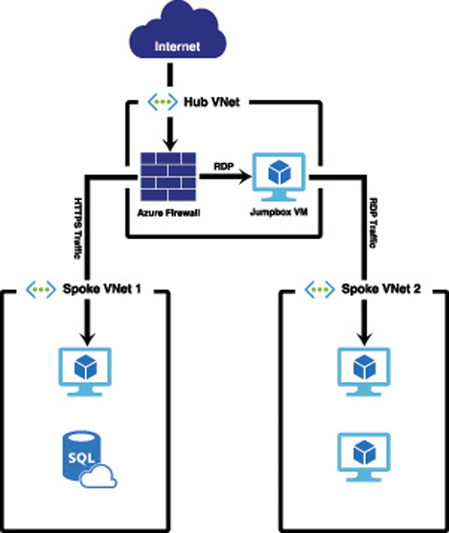
UNDERSTAND SECURING NETWORK CONNECTIVITY IN AZURE
An illustration of a typical hub and spoke configuration that also includes Azure Firewall. Traffic that comes from the Internet over port 443 (HTTPS traffic) is directed by the firewall to a web server running in Spoke VNet 1. Traffic that comes in over the remote desktop port is directed to the jumpbox VM, and users can then RDP from the jumpbox VM to a VM in Spoke VNet 2.
Azure Firewall

Slide 8
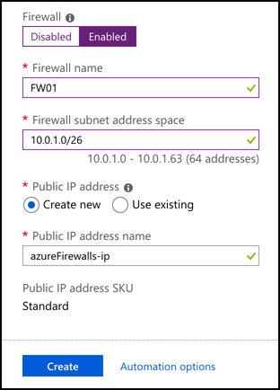
UNDERSTAND SECURING NETWORK CONNECTIVITY IN AZURE
Before you can configure a firewall to handle network traffic, you’ll need to create an instance of Azure Firewall. You can choose to include Azure Firewall when you create your virtual network in Azure, or you can create a firewall and add it to an existing virtual network.
When you create a firewall during the creation of a virtual network, Azure creates a subnet in the virtual network called AzureFirewallSubnet, and it uses the address space you specify for that subnet. A public IP address is also created for the firewall so that it can be accessed from the Internet.
Azure Firewall
Azure Firewall being created during the creation of a new virtual network

Slide 9
UNDERSTAND SECURING NETWORK CONNECTIVITY IN AZURE
You will also need to tell Azure to send traffic to the firewall, and then you’ll need to configure rules in the firewall so that it knows what to do with that traffic.
To send traffic to your firewall, you need to create a route table. A route table is an Azure resource that is associated with a subnet, and it contains rules (called routes) that define how network traffic in the subnet is handled.
A route table is created using the Route Table item in the Azure Marketplace. Once you create a new route table, you must associate it with one or more subnets:
To do that, click on Subnet and then click Associate
select the virtual network and the subnet
Azure Firewall

Slide 10
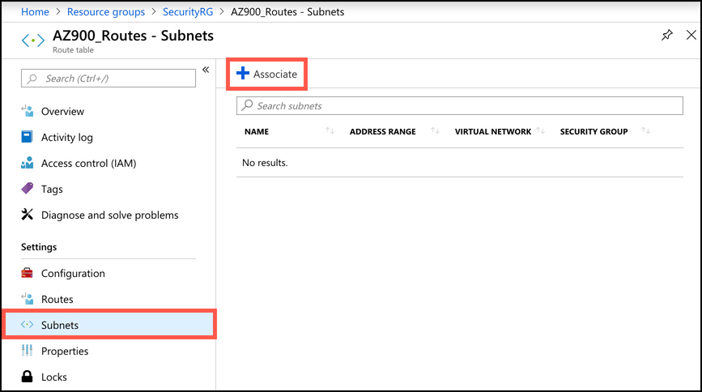
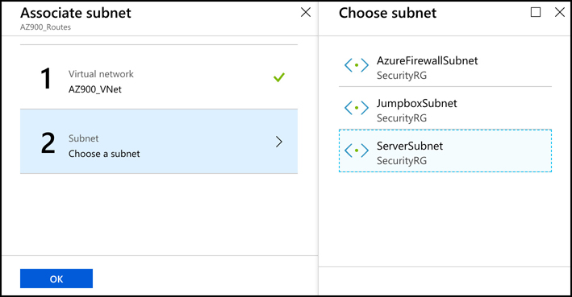
UNDERSTAND SECURING NETWORK CONNECTIVITY IN AZURE
Azure Firewall

Slide 11
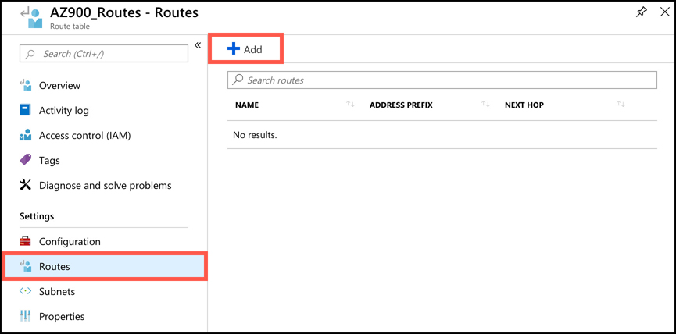
UNDERSTAND SECURING NETWORK CONNECTIVITY IN AZURE
Once we’ve associated the route table with the subnets, we create a user-defined route so that traffic is directed through Azure Firewall. To do that, click on Routes and then click Add
Azure Firewall

Slide 12
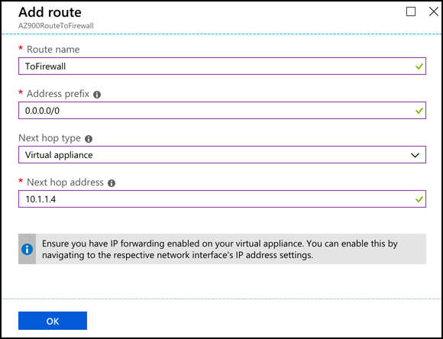
UNDERSTAND SECURING NETWORK CONNECTIVITY IN AZURE
This route is configured for 0.0.0.0/0, the notation for all traffic. It’s then sending that traffic to a virtual appliance (Azure Firewall in this case) located at IP address 10.1.1.4, which is the internal IP address of this firewall. Once this route is configured, it will immediately apply to all devices on the subnets associated with the route table.
Azure Firewall

Slide 13
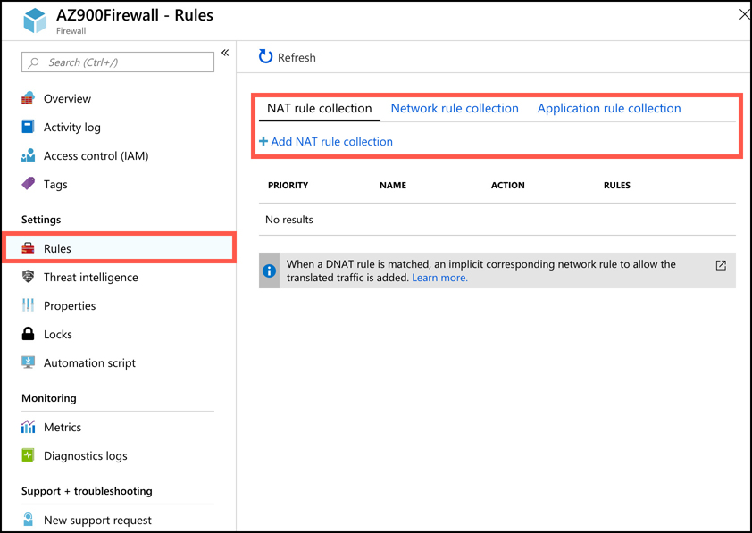
UNDERSTAND SECURING NETWORK CONNECTIVITY IN AZURE
Remember that Azure Firewall blocks all traffic by default, so at this point, there’s no way to reach the jumpbox VM that’s in the JumpboxSubnet. In order to access that VM, you must configure a firewall rule in Azure Firewall that will forward the appropriate traffic to the jumpbox VM.
To add a firewall rule, open Azure Firewall in the Azure portal and click on Rules, select the type of rule, and click the Add button
Azure Firewall

Slide 14
UNDERSTAND SECURING NETWORK CONNECTIVITY IN AZURE
There are three types of rule collections available in Azure Firewall.
Network address translation (NAT) rules These rules are used to forward traffic from the firewall to another device on the network.
Network rules These are rules that allow traffic on specific IP address ranges and ports that you specify.
Application rules Application rules are used to allow applications such as Windows Update to communicate across your network. They can also be used to allow particular domain names such as azure.com and microsoft.com.
Azure Firewall combines all of the rules of a specific type and priority into a rule collection. The priority is a number between 100 and 65,000. Lower numbers represent a higher rule priority and are processed first.
When network traffic enters the firewall, NAT rules are applied first. If the traffic matches a NAT rule, Azure Firewall applies an implicit network rule so that the traffic can be routed appropriately, and all further rule processing stops.
If there isn’t a NAT rule that matches the traffic, network rules are applied. If a network rule matches the traffic, all further rule processing is stopped. If there isn’t a network rule that applies to the traffic, the application rules are applied. If none of the application rules match the traffic, the traffic is rejected by the firewall.
Azure Firewall

Slide 15
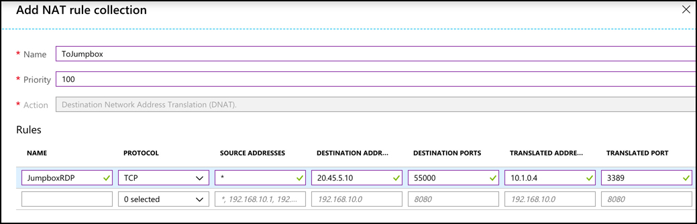
UNDERSTAND SECURING NETWORK CONNECTIVITY IN AZURE
To allow access to remote into the jumpbox VM, you might configure a NAT rule that forwards any traffic on port 55000 to port 3389 (the port for remote desktop) on the internal IP of the jumpbox VM. Because port 55000 is a general port that wouldn’t normally be used for remote desktop, someone with malicious intent would likely never discover that it’s being used for that purpose.
Azure Firewall

Slide 16
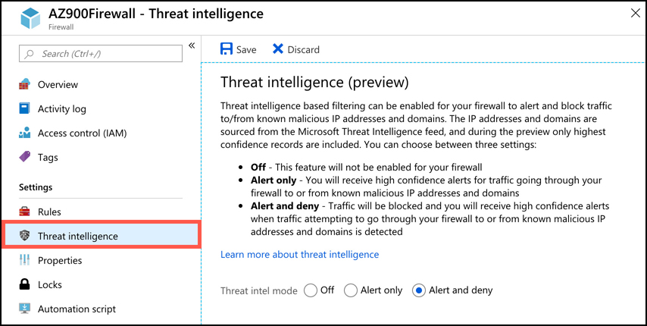
UNDERSTAND SECURING NETWORK CONNECTIVITY IN AZURE
Azure Firewall
In addition to rules that you configure, the threat intelligence feature (currently in preview) in Azure Firewall can protect you from known malicious IP addresses and domain names. Microsoft constantly updates their list of known bad actors, and the data collected is provided in the Microsoft Threat Intelligence feed.
For every hour that you have an Azure Firewall deployed, Microsoft will bill you $1.25. You are also billed $0.03 for every gigabyte of data processed by the firewall.

Slide 17
Agenda
Understanding securing network connectivity in Azure
DDoS protection
Network Security Groups
Choosing an appropriate Azure security solutions

Slide 18
DDoS protection
Azure can help protect against DDoS attacks with DDoS protection. DDoS protection is a feature of Azure Virtual Networks.
There are two tiers of DDoS protection; Basic and Standard.
Basic protects you from volume-based DDoS attacks by distributing large amounts of volume across all of Azure’s network infrastructure. Basic DDoS protection applies to both IPv4 and IPv6 public IP addresses. With the Basic tier, you have no logging or reporting of any DDoS mitigation, and there’s no way to configure alerts, so that you’re notified if a problem is detected. However, the Basic tier is free and provides basic protection.
The DDoS Standard tier offers protection not only from volume-based DDoS attacks, but when used in combination with Azure Application Gateway, it also protects from attacks designed to target the security of your applications. It offers logging and alerting of DDoS events and mitigations, and if you need help during a DDoS attack, Microsoft provides access to experts who can help you. The DDoS Standard tier applies only to IPv6 public IP addresses.

Slide 19
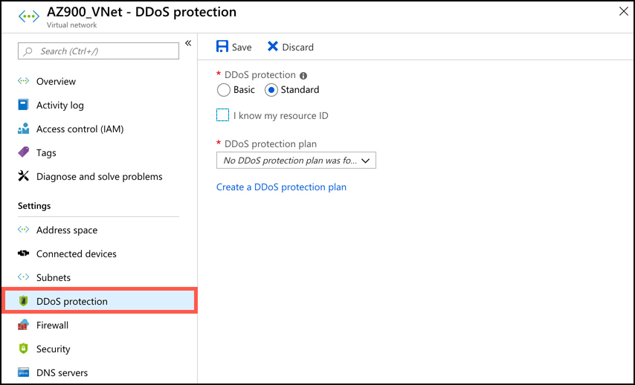
DDoS protection
The Standard tier is targeted at enterprise customers and is billed at $2,994.00 per month, plus a small fee per gigabyte for data that is processed. The fixed monthly price covers up to 100 resources. If you need to cover additional resources, you pay an additional $30.00 per resource per month.
To enable the DDoS Standard tier, click DDoS Protection in your virtual network in the Azure portal and select Standard.

Slide 20
DDoS protection
To enable Standard tier, you’ll need a DDoS protection plan. If you don’t currently have one, click Create A DDoS Protection Plan to create one in the Azure portal. You can then apply that DDoS protection plan to your virtual network and to other virtual networks that you have access to in Azure. Virtual networks that use the DDoS protection plan aren’t required to be in the same subscription, so in most cases, an organization will only need a single DDoS protection plan to protect all of their virtual networks.
DDoS protection Standard tier monitors your network traffic 24/7, and it uses machine learning to profile your traffic over time and adjust itself to accommodate your network’s traffic profile. During a DDoS event, Standard tier allows you to stream logs to a security information and event management (SIEM) system. SIEM systems are designed to allow for the aggregation of data from a large number of sources for the purpose of analysis, and to comply with data retention policies and standards.
Once you’ve configured any alerts and monitoring for DDoS protection, you can simulate a DDoS event using a BreakingPoint Cloud account available at: https://www.ixiacom.com/products/breakingpoint-cloud. This allows you to ensure that your DDoS protection is protecting you from DDoS attacks.

Slide 21
Agenda
Understanding securing network connectivity in Azure
DDoS protection
Network Security Groups
Choosing an appropriate Azure security solutions

Slide 22
Network Security Groups
A Network Security Group (NSG) allows you to filter traffic on your network and apply rules on that traffic. An NSG contains several built-in rules provided by Azure that are designed to allow your resources in the virtual network to communicate with each other. You can then add your own rules to the NSG to control traffic into and out of the network, and also between resources in the network.
NSGs can be associated with a subnet or to a network interface attached to a VM. Each network interface or subnet can only have one NSG associated with it, but you can create up to 1,000 rules in a single NSG, so you should be able to easily apply all of the rule logic necessary for any task.
If you associate an NSG to both a subnet and to one or more network interfaces inside of that subnet, the rules for the NSG associated with the network interfaces are first applied, and then the subnet’s NSG’s rules are applied.
To prevent rules from interfering with each other, each rule you create in an NSG has a priority between 100 and 4,096. Rules with a lower priority take precedence over rules with a higher priority. Network traffic is applied against the rule with the lowest priority number first. If the traffic matches that rule, the rule is applied, and processing of the rule stops. If the traffic doesn’t match the rule, it is evaluated against the next lowest priority rule.

Slide 23
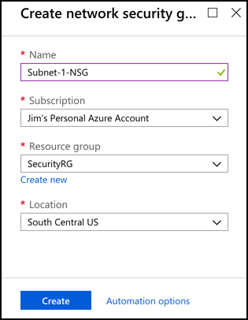
Network Security Groups
To create an NSG, search for Network Security Group in the Azure Marketplace. When you create an NSG, give it a name, choose or create a resource group, and specify the location for the NSG

Slide 24
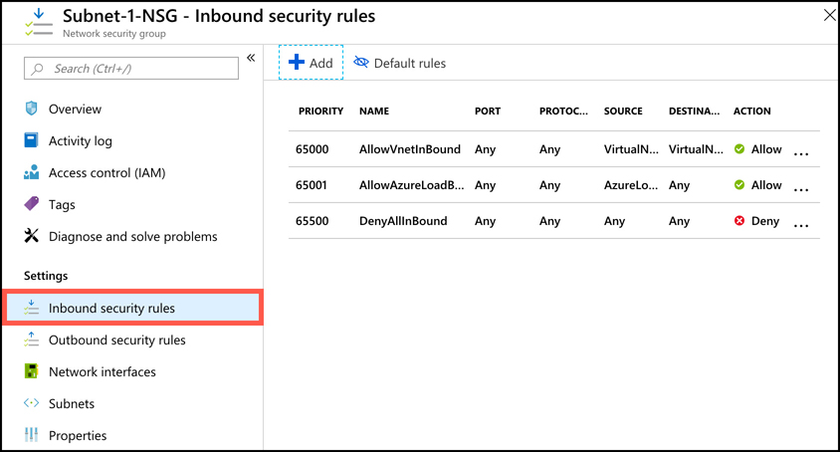
Network Security Groups
After you create an NSG, you can then add inbound and outbound rules for the NSG. Once you open the NSG in the Azure portal, click Inbound Security Rules to add new inbound rules, and Outbound Security Rules to add outbound rules.

Slide 25
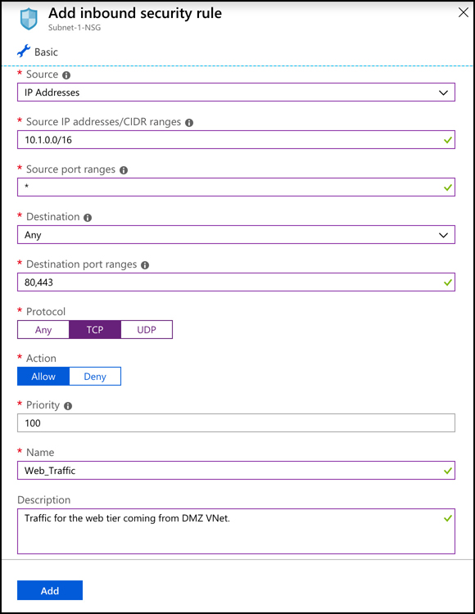
Network Security Groups
Click Add to add a new NSG rule

Slide 26
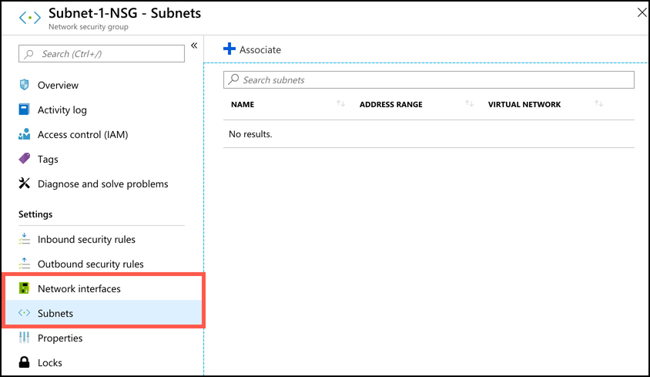
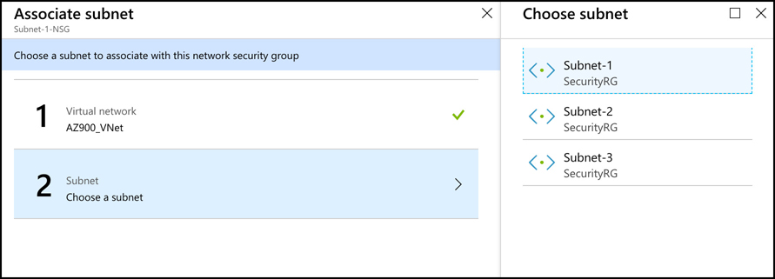
Network Security Groups
Click Subnets to associate an NSG with a subnet, or Network Interfaces to associate it with a network interface used by a VM. Then click Associate

Slide 27
Network Security Groups
Outbound security rules are created in the same way that inbound rules are created. You aren’t required, however, to create a corresponding outbound rule for every inbound rule. NSGs maintain what’s called a flow record that stores the state of a connection, and the NSG will allow traffic that corresponds to that flow record without an explicit rule. If a security rule allows inbound traffic to port 80 from IP addresses in the range of 10.1.0.0/16, the NSG will also allow outbound traffic on port 80 to addresses in that same range using the flow record. Only once traffic stops flowing for a few minutes, will the flow record no longer be in effect.

Slide 28
Network Security Groups
There are some cases where you won’t know the specific IP address range. For example, if you want to configure an NSG rule on a virtual network that allows all traffic from the Internet, you wouldn’t specify an exact address range. To deal with that, NSGs allow you to use service tags when configuring rules.
A service tag is a special identifier created by Microsoft that applies to the Internet or to a specific service type within Azure. For example, if you have some web apps running in Azure App Service, and you want to allow them to communicate with your subnet, you can use the AppService service tag in your inbound rule to allow that. Azure services also have region-specific service tags so that you can allow or deny traffic only from specific regions

Slide 29
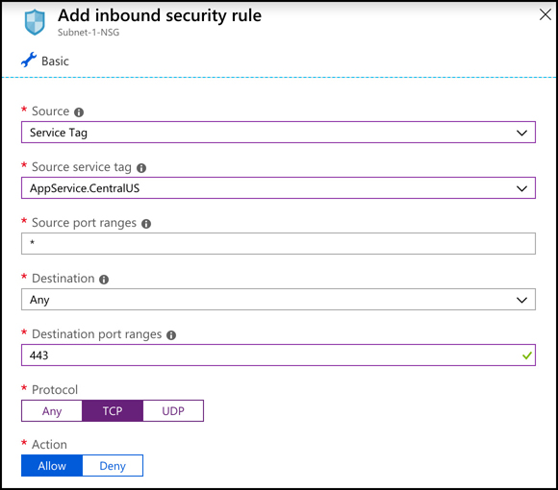
Network Security Groups
To use a service tag, set the Source of your rule to Service Tag. You can then select a service tag from the Source service tag dropdown.
In example, the AppService.CentralUS service tag is being used to allow traffic from Azure App Service resources in the Central US region.

Slide 30
Agenda
Understanding securing network connectivity in Azure
DDoS protection
Network Security Groups
Choosing an appropriate Azure security solutions

Slide 31
Choosing an appropriate Azure security solution
Depending on your application and its configuration, you may or may not need all of the security solutions we’ve discussed. NSGs should be considered in almost all scenarios to ensure that only the desired network traffic flows between your resources. If your application is exposed to the Internet, NSGs can ensure that traffic from the Internet is only allowed into specific subnets or VMs. Even if you aren’t using a public-facing IP address, NSGs can help you enforce secure communication between layers of an application.
Azure Firewall is a powerful way to ensure that traffic into your virtual networks is tightly controlled. Unlike an NSG, Azure Firewall is a stateful solution that understands the makeup of a network connection and can identify if an attack is being attempted on your network. Azure Firewall is not necessary, however, If your application doesn’t expose a public IP address.
DDoS protection is an effective means of protecting your network from attacks designed to impact your applications with a large volume of seemingly legitimate traffic. You can add another layer of protection by using Application Gateway alongside of DDoS protection Standard tier to protect against security threats to the application.

